Slide 1
Nutritional Deficiency Diseases
poultry diseases
fourth stage
Dr. Isam Azeez
Department of Pathology and Poultry Disease
College of Veterinary Medicine university of Basrah

Slide 2
Nutritional diseases
Factors leading to nutritional diseases
Human error
Improper formulation
Ingredient variation and antagonism
Malabsorption
Overproduction -- underconsumption
Feed separation - especially with calcium in chain feeders
Oxidation of ingredients

Slide 3
What are the vitamins?
A group of organic substances present in minute amounts in natural feedstuff.
Essential for normal metabolism.
Insufficient amounts in the diet may cause deficiency diseases.

Slide 4
Thiamin (Vitamin B1)
The active form of thiamin is thiamin pyrophosphate, which is an important cofactor in decarboxylation, dehydrogenase, and transketolase reactions.

Slide 5
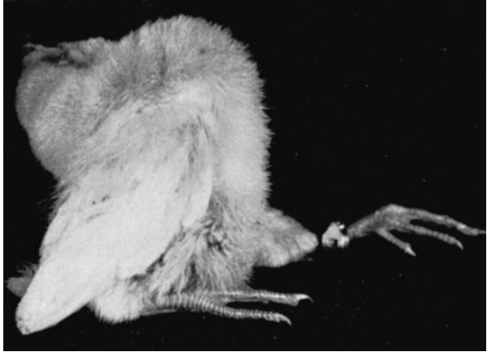
Vit.B1(thiamin deficiency) Stargazing
Typical stargazing pose displayed by a chick suffering from thiamin deficiency.

Slide 6
Riboflavin (Vitamin B2)
Riboflavin is a cofactor in more than 50 enzymes, many of which are vitally associated with oxidation‐reduction reactions involved in cell respiration.

Slide 7
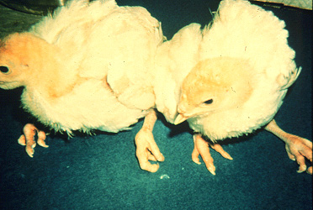
Vit.B2 ( Riboflavin deficiency)
Curled‐toe paralysis (riboflavin deficiency). Typical signs include poor growth, reluctance to stand or walk, sitting on hocks, and toes curled inward

Slide 8
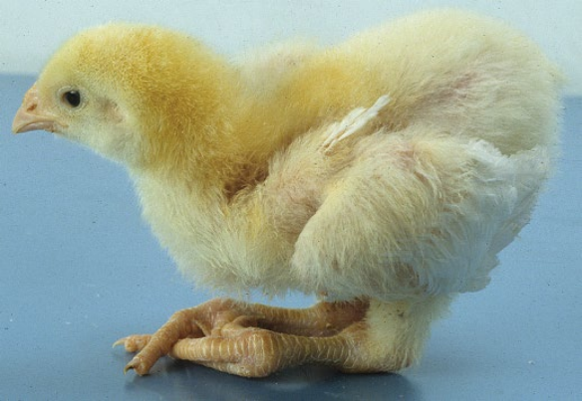
Curled‐toe paralysis (riboflavin deficiency). Typical signs include poor growth, reluctance to stand or walk, sitting on hocks, and toes curled inward

Slide 9
Vit.B2( Riboflavin deficiency)
Curled toe paralysis and Toes curled inward

Slide 10
Vit.B2( Riboflavin deficiency)
Enlarged sciatic nerve

Slide 11
Biotin
Biotin is a cofactor in carboxylation and decarboxylation reactions involved in the metabolism of lipids, glucose, and some amino acids.

Slide 12
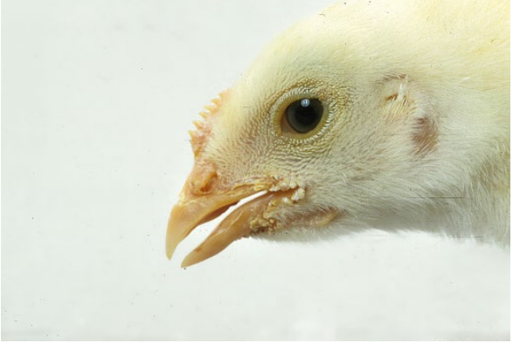
Dermatosis at the corners of the beak. Biotin deficiency.

Slide 13
Gout
What are the Different Forms of Gout?
Articular Gout:
The accumulation of urates within the synovial capsules and tendon sheaths of the joints, including the toes of the feet.
Visceral Gout:
The precipitation of uric acid crystals along the surface of internal visceral organs and other sites within the body.

Slide 14
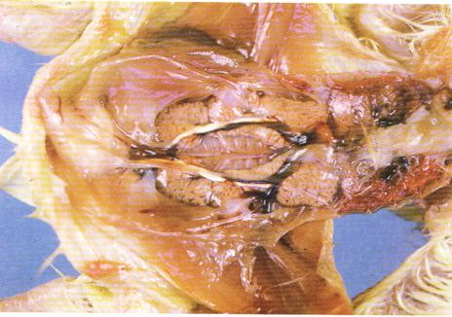
Visceral gout
Kidneys are enlarged The ureters are enlarged and packed with urate (white chalky material)

Slide 15
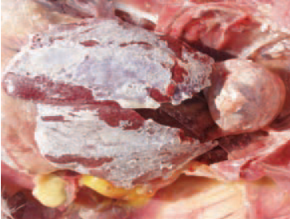
The visceral gout is manifested with the deposition of urates in renal tubules and the serous coats of the heart, the liver, the mesentery, the air sacs, or the peritoneum.

Slide 16
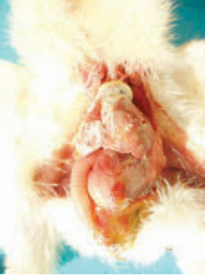
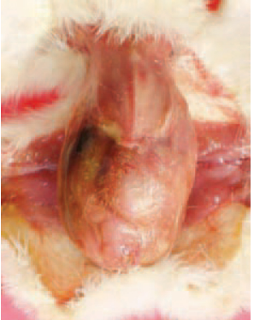
Most commonly, visceral gout following dehydration is observed in newly hatched chickens after overheating or a more prolonged stay in the hatchery. Visceral gout outbreaks are related to vitamin A deficiency.

Slide 17
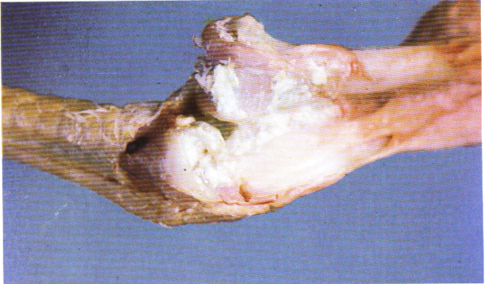
Articular gout
deposition of urates in the joint

Slide 18
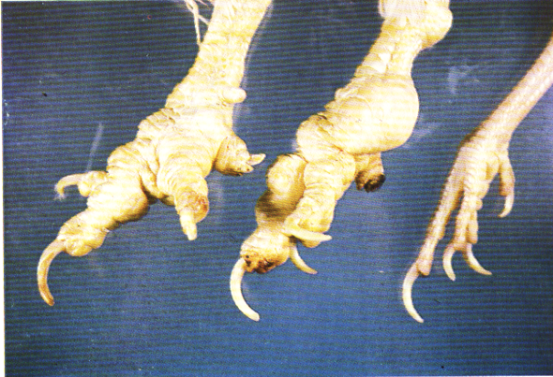
Articular gout
deposition of urates in the joint

Slide 19
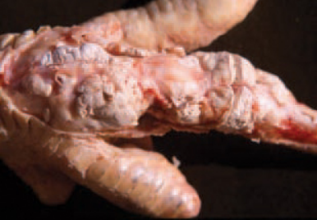
After the opening of affected joints, the periarticular tissue is white. A white semi-liquid matter, due to urate deposits.

Slide 20
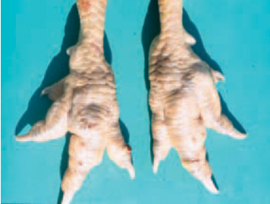
articular gout is characterized by periarticular urate deposits (tophi), especially around the joints of the toes and the foot. The joints are enlarged, and toes – are malformed.

